Slide 1


Final Year Project
Diabeto-Vision
Diabetic retinopathy detection with fundus Images
Supervised By: Tajamal Shahzad (FC: Lecturer)

Slide 2
Project Team
Mudabbir Ahmed (35830)
Malik Saad Munaf (38748)
Saad bin Rizwan (37968)

Slide 3
Table of Content
Background and Introduction
Literature Review
Problem Statement
Project Scope
Proposed Solution
Requirements Summary
Design Summary
Methodology
Implementation Summary
Experiments and Results Summary
Testing Summary
Conclusion and Outlook

Slide 4
BACKGROUND AND INTRODUCTION

Slide 5
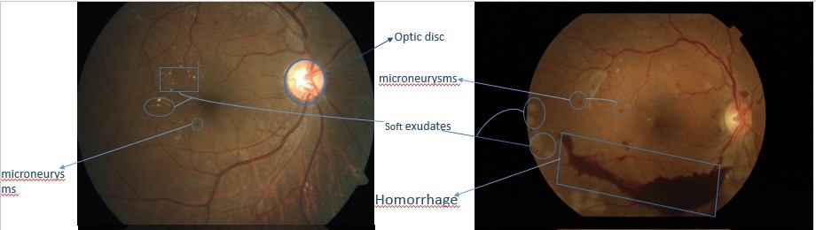
Background and Introduction(1/2)
Diabetic Retinopathy:
Diabetic Retinopathy is a diabetes-related eye disease that damages the retina's blood vessels, potentially leading to blurry vision, difficulties seeing floaters vision loss in sever cases.
It is the six leading cause of global blindness(Pandey and Sharma, 2018)
Figure 1 illustrate or infected fundus image.
Figure 1

Slide 6
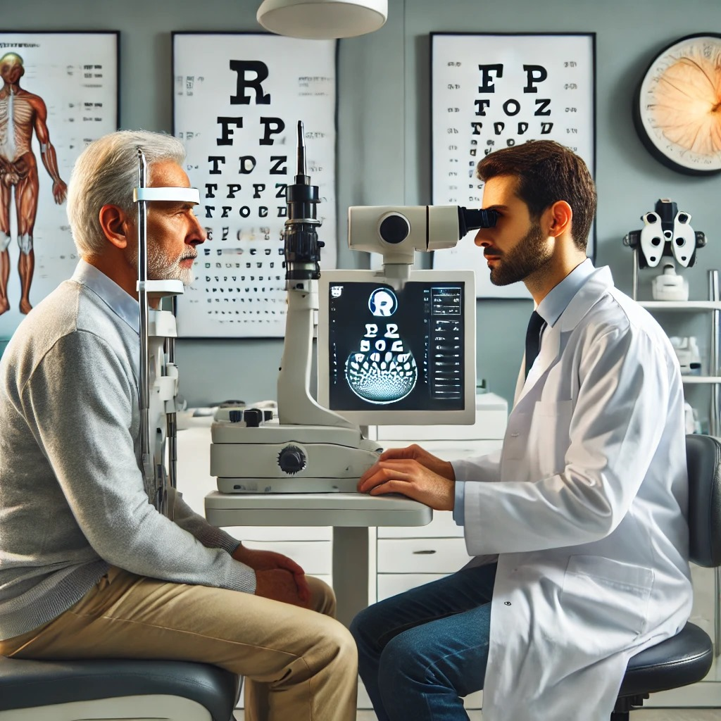
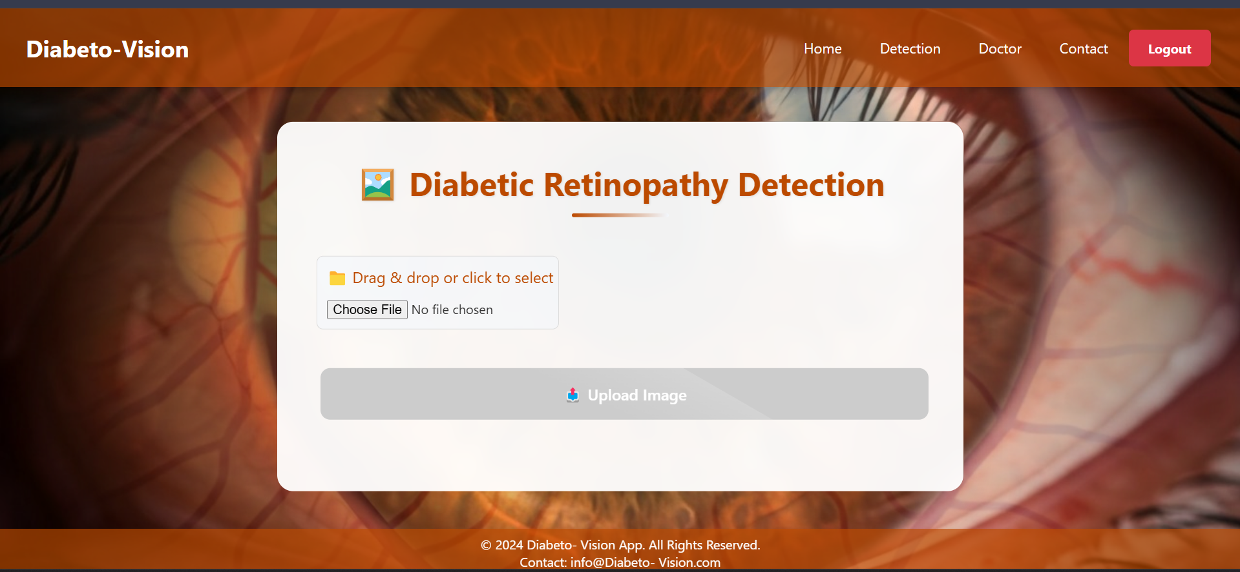
Background and Introduction(1/2)
Diabetic Retinopathy Detection:
Traditional method: Ophthalmologist visit the patient that is very time consuming shown in [Figure 2]
Vision method: Vision method refers to analyzing retinal fundus images using AI to detect diabetic retinopathy and classify it stages (Quick, Reliable) shown in [Figure 3].
Figure 2
Figure 3

Slide 7
Literature Review

Slide 8
Literature Review 1/2
Study 1: A modified ResNet18 with Swish activation and data augmentation achieved 93.51% accuracy on the APTOS dataset.
Study 2: Fine-tuned Efficient Net B0 with L2 regularization and CLAHE preprocessing improved DR detection performance significantly.
Study 3: An ensemble of EfficientNetB2, DenseNet121, and ResNet50 with data fusion showed top accuracy among multi-class DR models.
Study 4: GAN-based augmentation with InceptionResNetv2 reached 96% accuracy, reducing overfitting and enhancing DR classification.
Study 5: DiaGAN-CNN combined GAN-generated images and transfer learning to boost diagnostic accuracy for diabetic retinopathy.

Slide 9
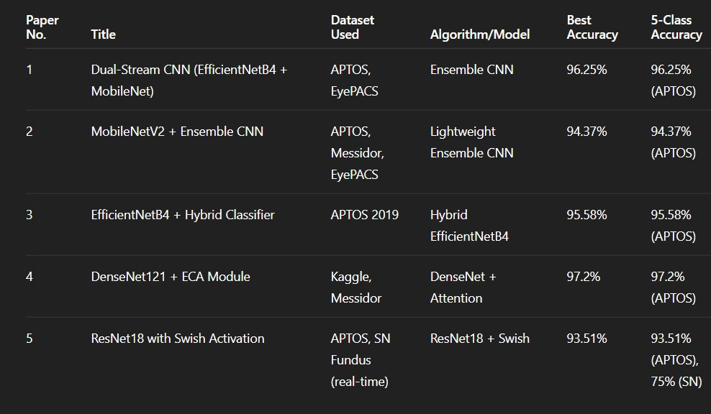
Literature Review 1/2
Summary Table:

Slide 10
PROBLEM STATEMENT

Slide 11
Problem Statement
Manual diagnosis of diabetic retinopathy is inefficient, error
prone, and lacks scalability. Automated CNN-based systems
address these challenges but face issues such as imbalanced
datasets, computational limitations, and generalizability. This
project aims to develop an efficient, accurate, and scalable
CNN-based solution for DR detection, bridging these gaps and
improving accessibility in diverse healthcare environments.

Slide 12
Project Scope

Slide 13
Project Scope
The scope of this project is to develop an intelligent system for the automated detection and classification of diabetic retinopathy (DR) from retinal fundus images. The primary goal is to assist ophthalmologists in early diagnosis and grading of DR, which is critical in preventing vision loss.
This system will leverage deep learning techniques, particularly convolutional neural networks (CNNs), trained on preprocessed fundus images to classify them into various stages of DR (e.g., No DR, Mild, Moderate, Severe, Proliferative).

Slide 14
PROPOSED SOLUTION

Slide 15
Proposed Solution
The Diabetic Retinopathy Detection System is a machine learning-based solution that uses a trained deep learning model to identify the presence and stage of diabetic retinopathy from retinal images. The system is accessible via a web application, making it user-friendly and scalable

Slide 16
Project Report Summary:

Slide 17
Requirements Summary 1/5
Functional Requirements:
Admin
Doctor
Patient

Slide 18
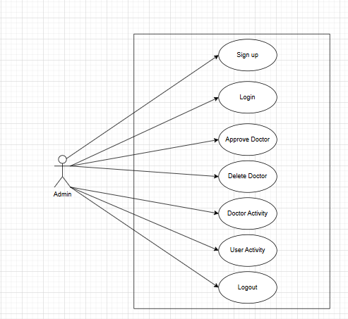
Requirements Summary 2/5
Use Cases:
Admin Usecase:

Slide 19
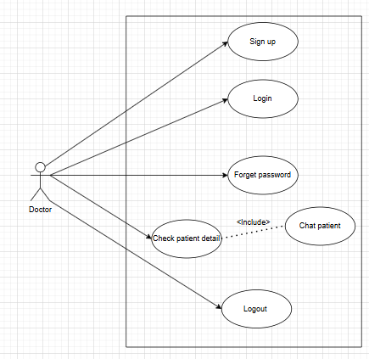
Requirements Summary 3/5
Doctor Usecase:

Slide 20
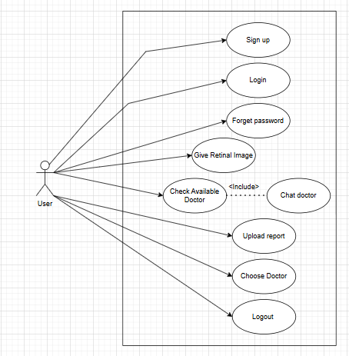
Requirements Summary 4/5
User Usecase:

Slide 21
Requirements Summary 5/5
Non-Functional Requirements:
The deep learning model shall utilize datasets like Aptos and IDRiD to achieve high accuracy in DR detection.
The system shall maintain a response time under 5 seconds for image analysis.
MongoDB shall be used to ensure efficient and secure storage of patient and image data.
The web interface shall be intuitive and user-friendly, enabling easy upload and result retrieval.

Slide 22
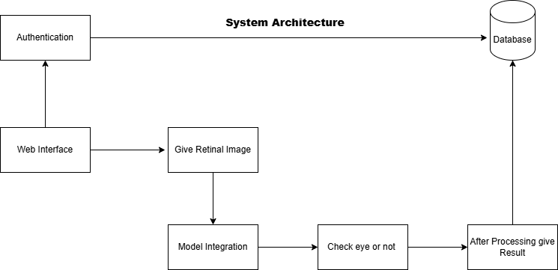
Design Summary 1/4
System Design:

Slide 23
Design Summary 2/4
System Design in Detail:
User / Patient:
First Register himself as a patient.
After successfully login the have access for giving his retinopathy image to system for detection
After that they got result in the pdf format
If user want to chat with doctor then chat and also send his report.

Slide 24
Design Summary 3/4
Doctor:
Docter first register himself and submit the form
After approval the admin doctor can be added otherwise he will be rejected
And after that he saw the patient, chat with them and also saw reports.

Slide 25
Design Summary 4/4
Admin:
Admin first login himself as a owner of whole website
He have access to saw the Patient/User activity and Doctor activity
Admin have the access to approve the doctor or not

Slide 26
Methodology (1/3)
The overall proposed methodology for the Diabetic Retinopathy Detection
system can be divided into three main phases
Phase 1: Data preparation.
Dataset Collection
Data Annotation
Phase 2: Model development.
Model Training
Testing and Validation.
Phase 3: Deployment and User interaction
Web Integration
User interaction
Doctor interaction
Result Generation
Downloading report in pdf

Slide 27
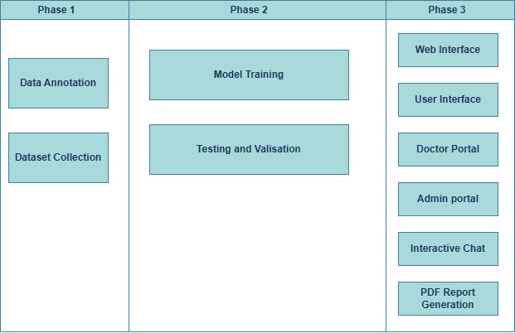
Methodology (2/3)

Slide 28
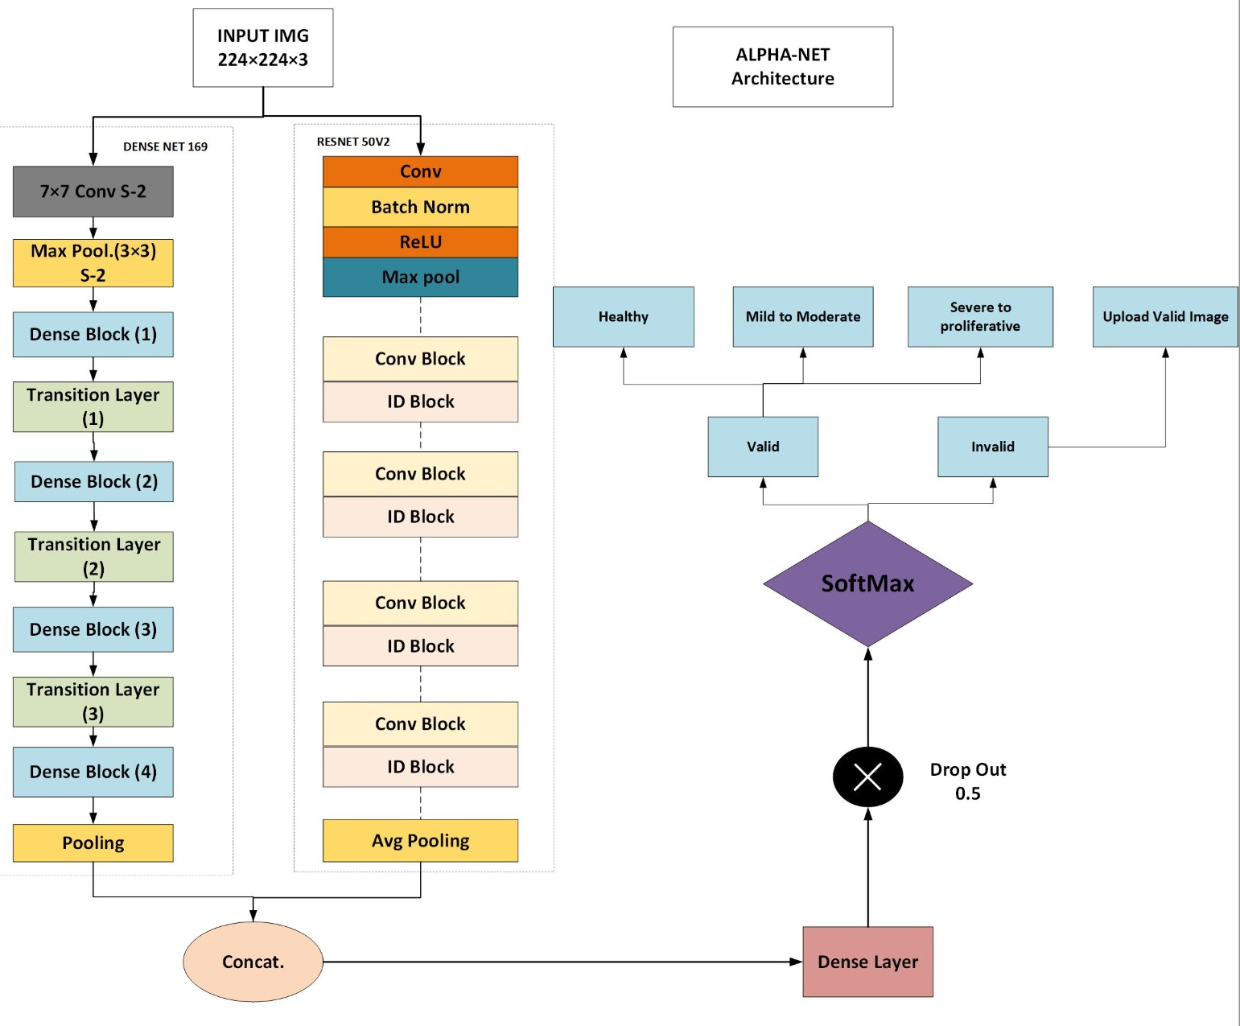
Methodology (3/3)
CNN Architecture:

Slide 29
Implementation Summary 1/2
Programming language :
Python for Machine learning model development and testing
Framework and libraries:
Tensorflow /Keras for implementing CNN architectures.
React.js for Frontend
Node.js for Backend server development
MongoDB for Database

Slide 30
Implementation Summary 2/2
Development Platforms:
Google Collab:
For leveraging GPU resources
Vs Code:
For Coding and debugging

Slide 31
Experiments and Results Summary 1/3
We are using Alpha net model that is the combination of ResNet50V2 and DenseNeT169 that is also called Hybrid Model.
We are handled three classes in our model.
Healthy
Mild to Moderate
Severe to proliferative
In next we will show the accuracy, F1 score, precision and Recall

Slide 32
Experiments and Results Summary 2/3
 | Precision | Recall | F1-score | Support
Healthy | 0.97 | 0.98 | 0.98 | 395
Mild-to- Moderate | 0.91 | 0.84 | 0.87 | 313
Severe-to- proliferative | 0.73 | 0.84 | 0.78 | 130
Accuracy |  |  | 0.91 | 838
Macro avg | 0.87 | 0.89 | 0.88 | 838
Weighted avg | 0.91 | 0.91 | 0.91 | 838

Slide 33
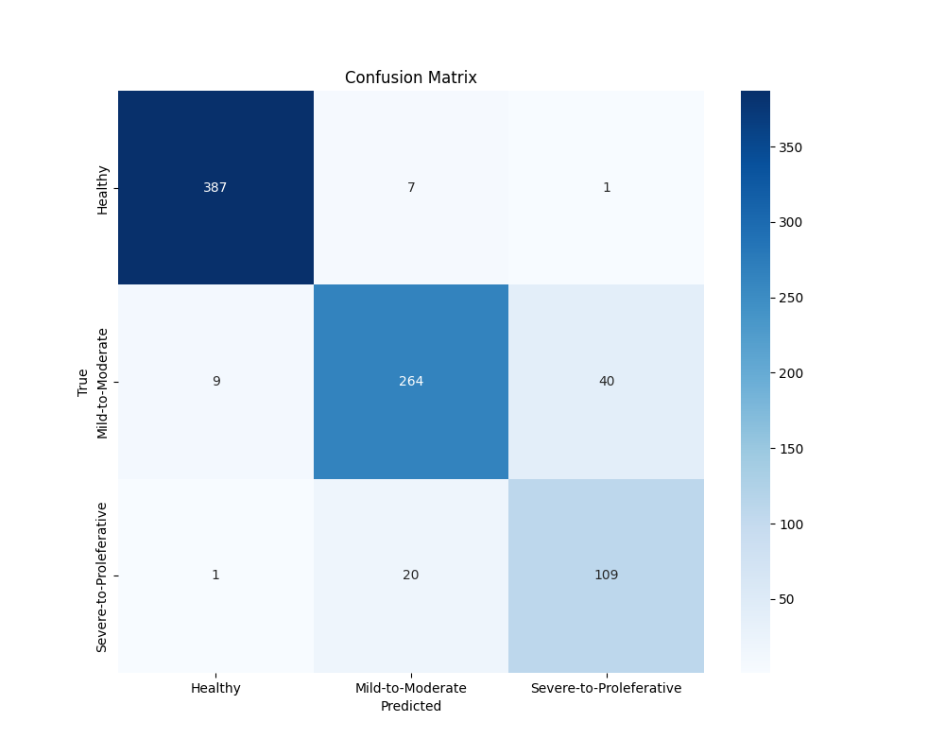
Experiments and Results Summary 3/3
Confusion Matrix:

Slide 34
Testing Summary
Test cases were designed based on the functional use cases for Admin, Doctor, and Patient roles.
Manual testing was conducted in a staging environment using real interaction scenarios.
Modules Tested:
Admin Panel
Doctor panel
Patient Panel

Slide 35
ENDEAVOUR

Slide 36
Endeavour
Describe roles of your team members
Mudabbir Ahmed:
Documentation
Website Backend Data Collection
Saad Munaf:
Data Collection
Model Training
ML work
Saad Rizwan:
Website Front end
Website Back end
Documentation

Slide 37
CONCLUSION AND OUTLOOK

Slide 38
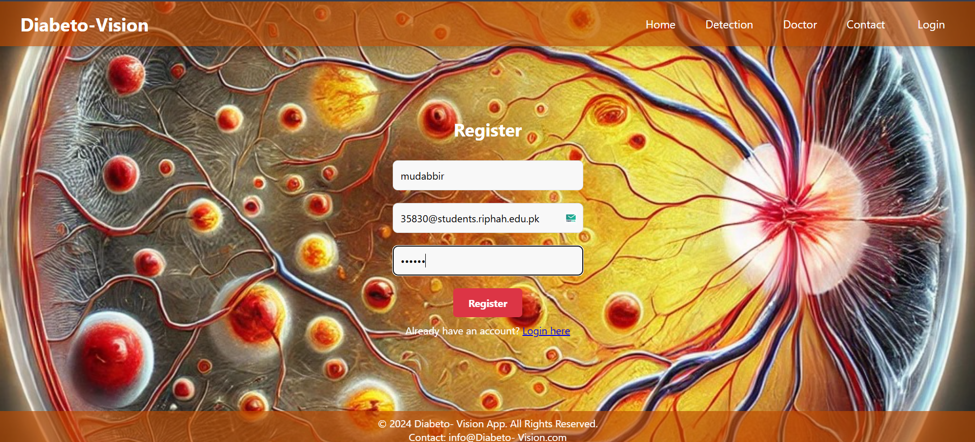
Outlook(1/16)
Patient Registration:

Slide 39
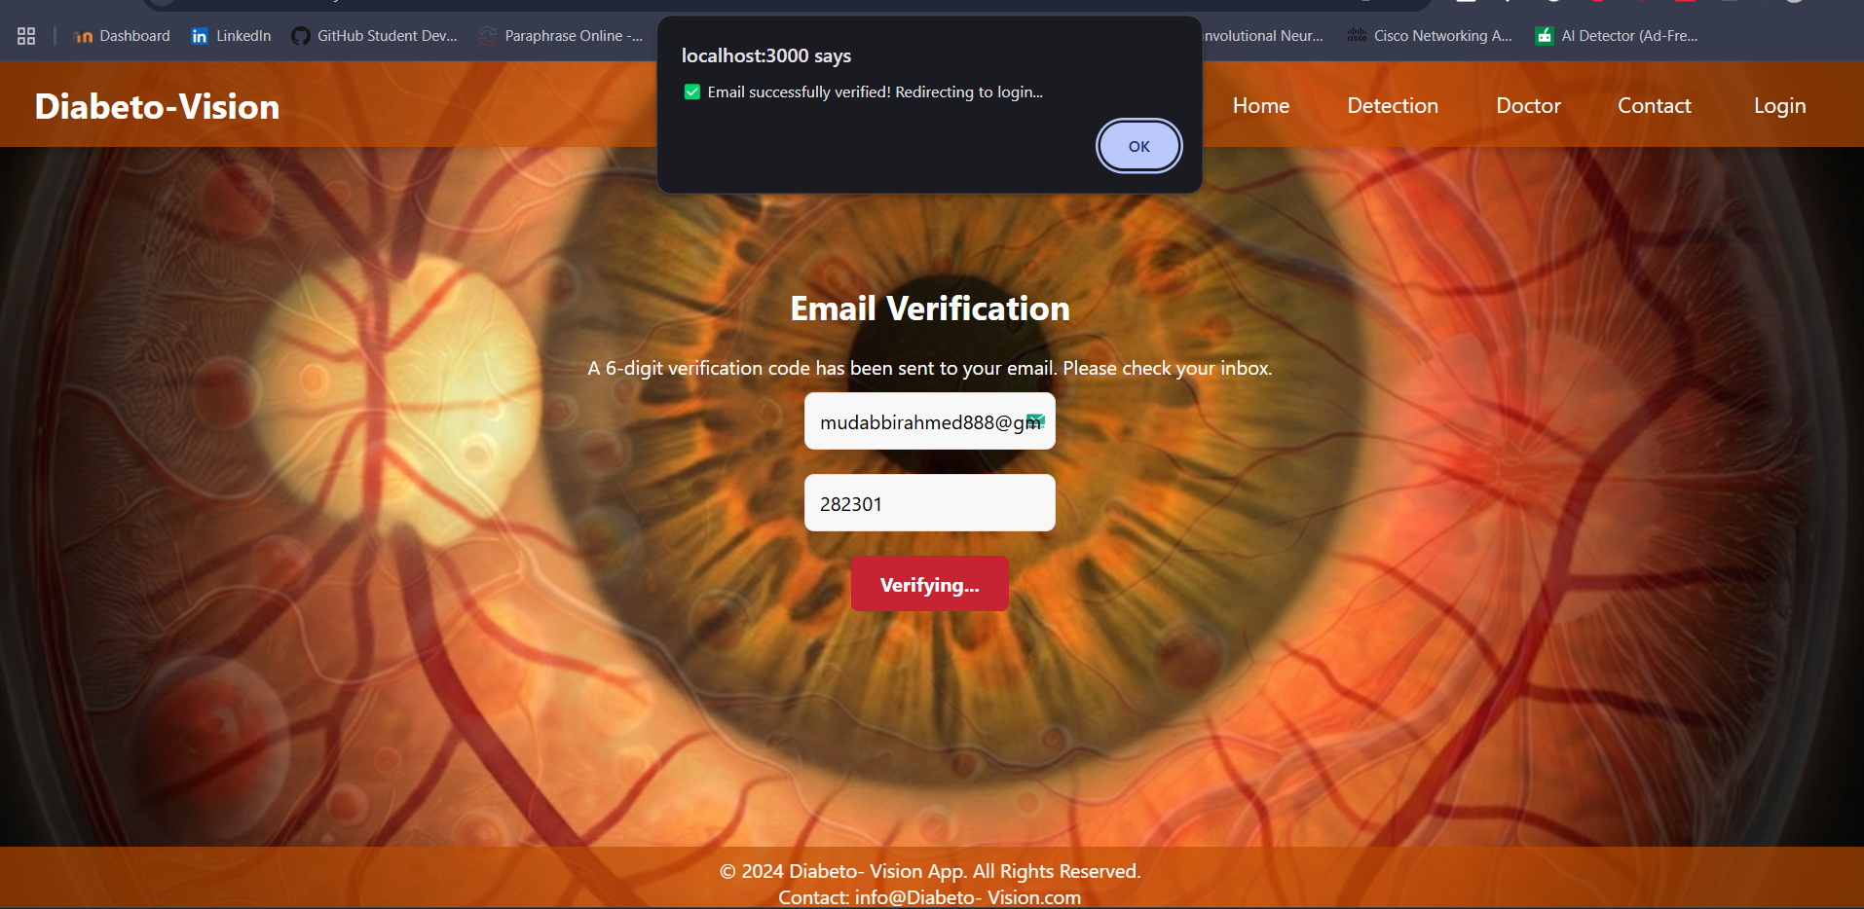
Outlook(2/16)
Email Verification:

Slide 40
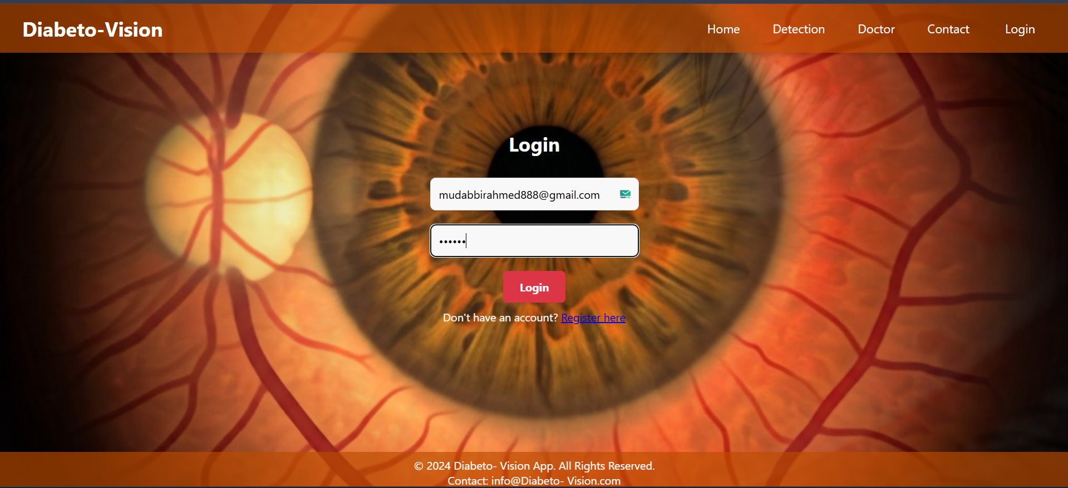
Outlook(3/16)
Doctor Login:

Slide 41
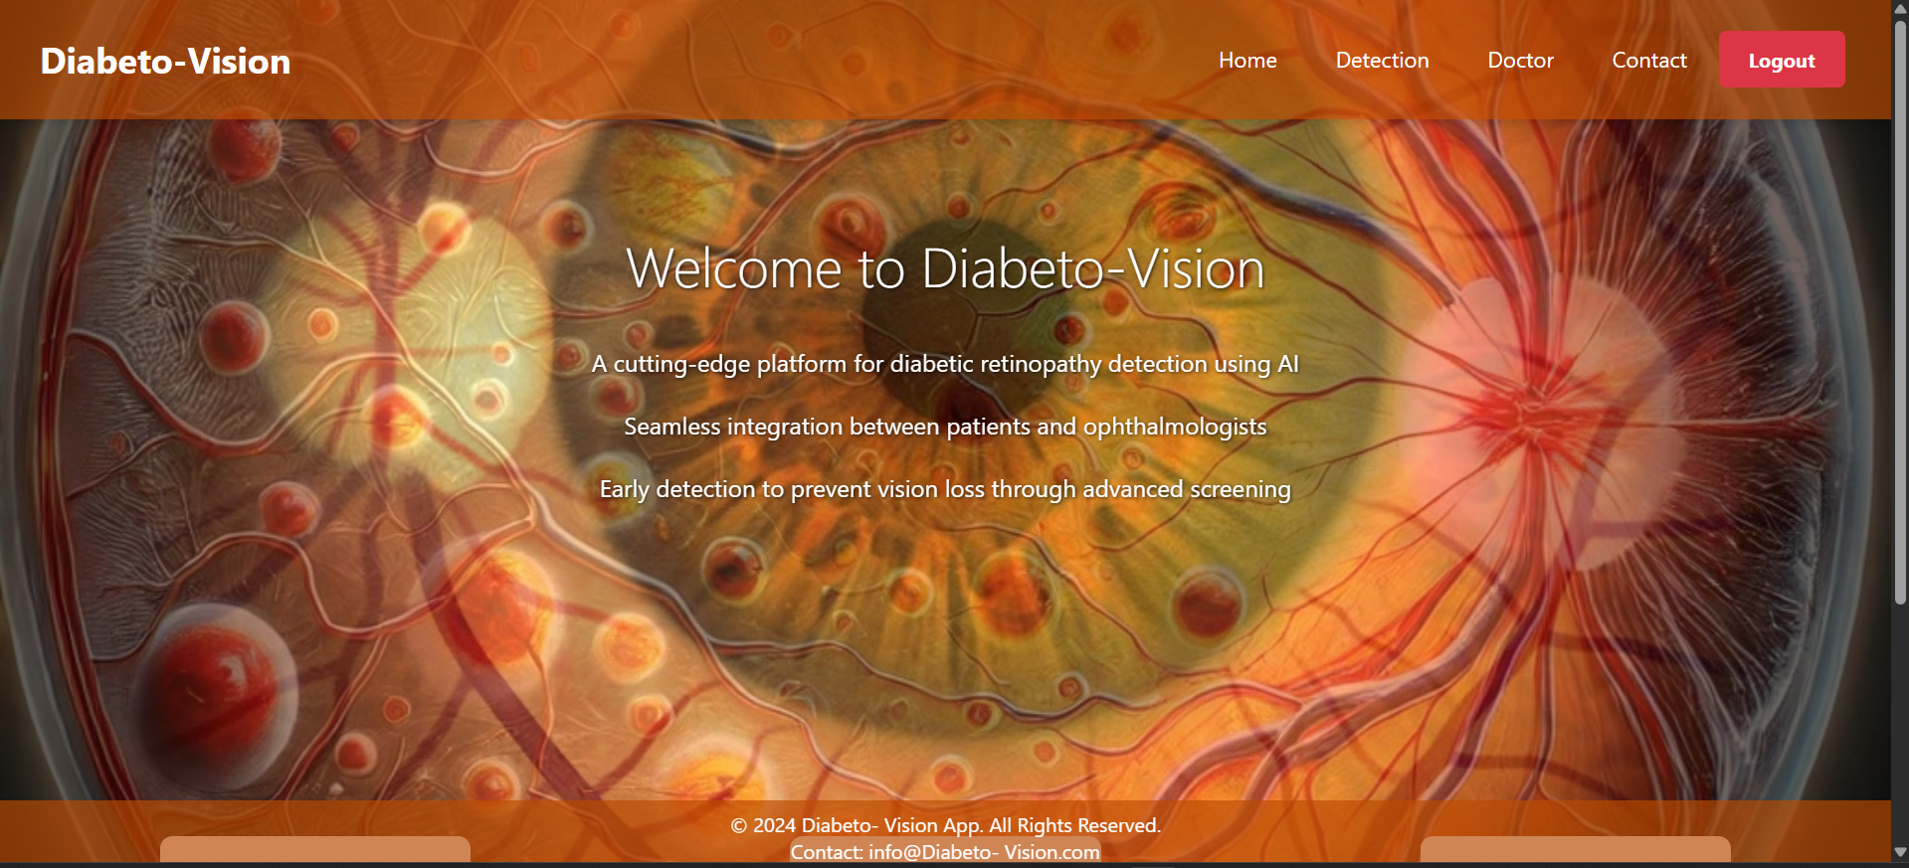
Outlook(4/16)
Homepage:

Slide 42
Outlook(5/16)
Detection Page:

Slide 43
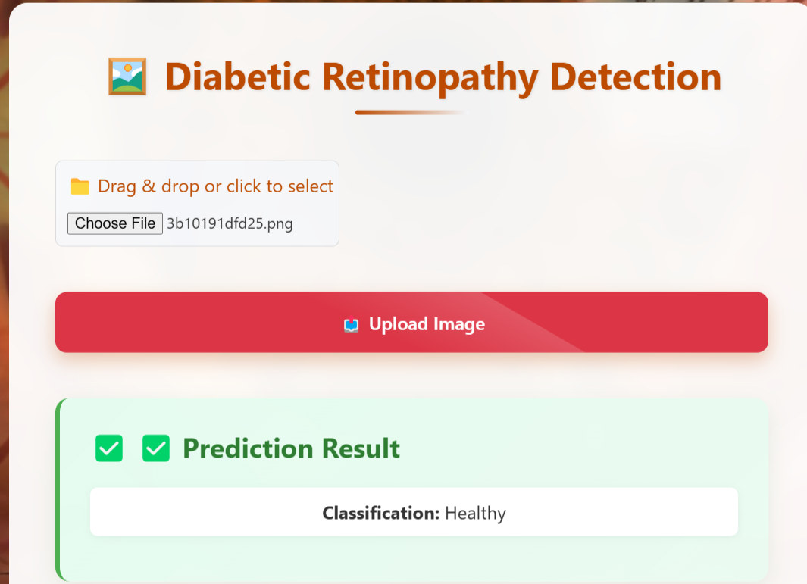
Outlook(6/16)
Prediction Result Healthy:

Slide 44
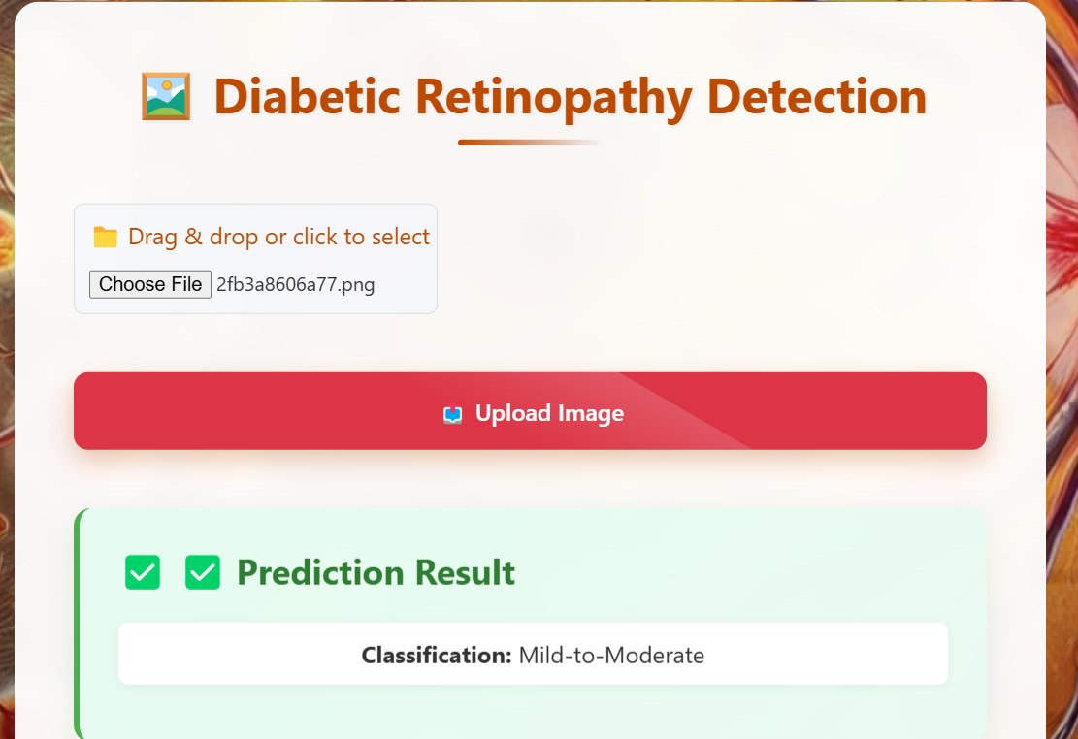
Outlook(7/16)
Prediction Result Mild:

Slide 45
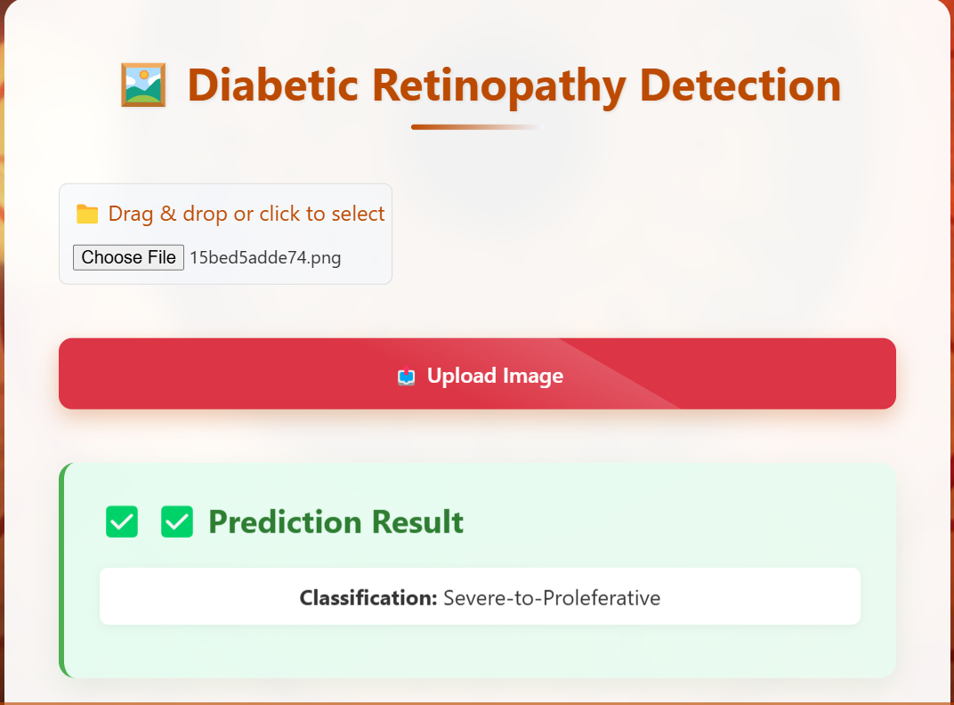
Outlook(8/16)
Prediction Result Severe:

Slide 46
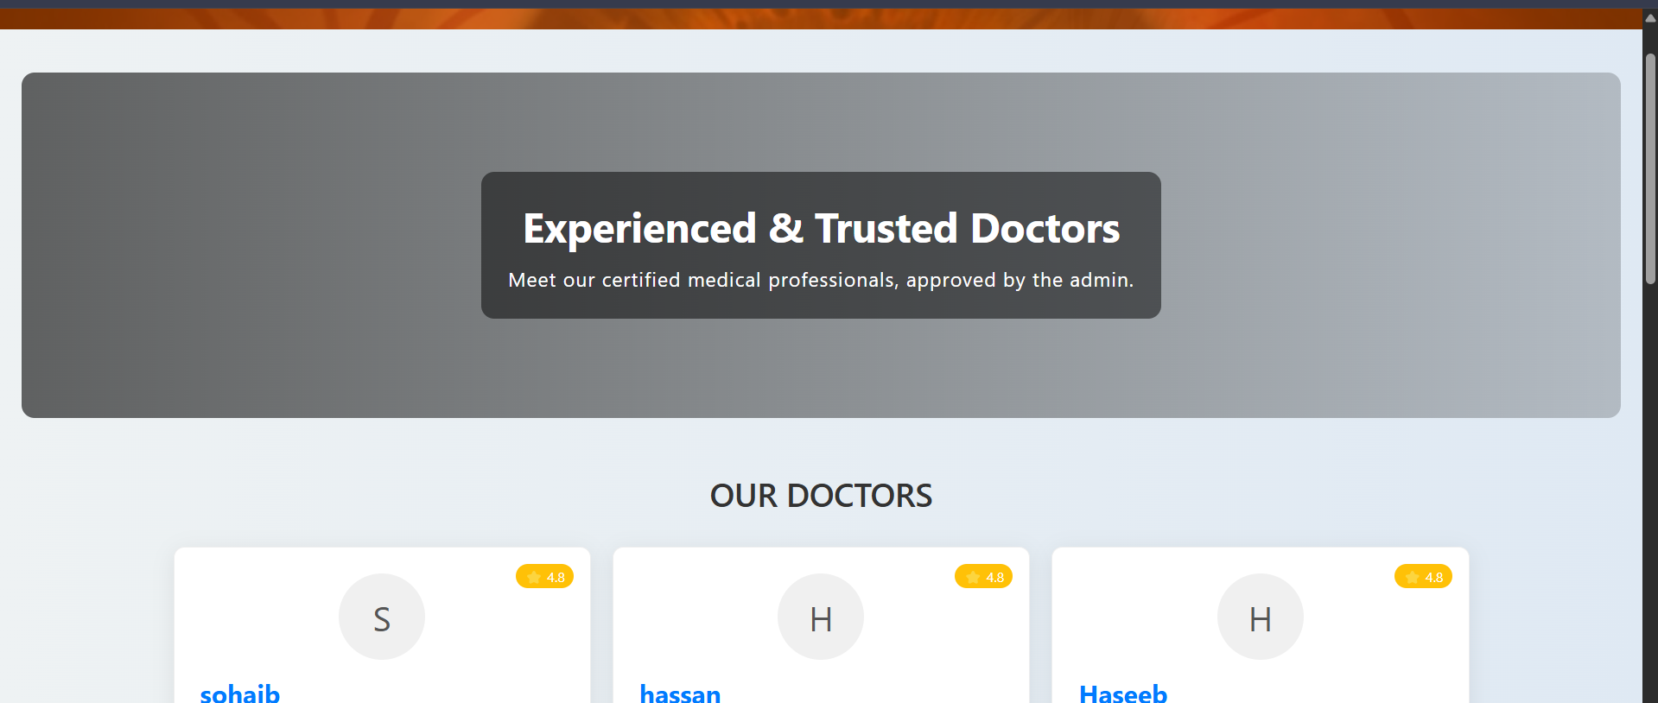
Outlook(9/16)
Trusted Doctors:

Slide 47
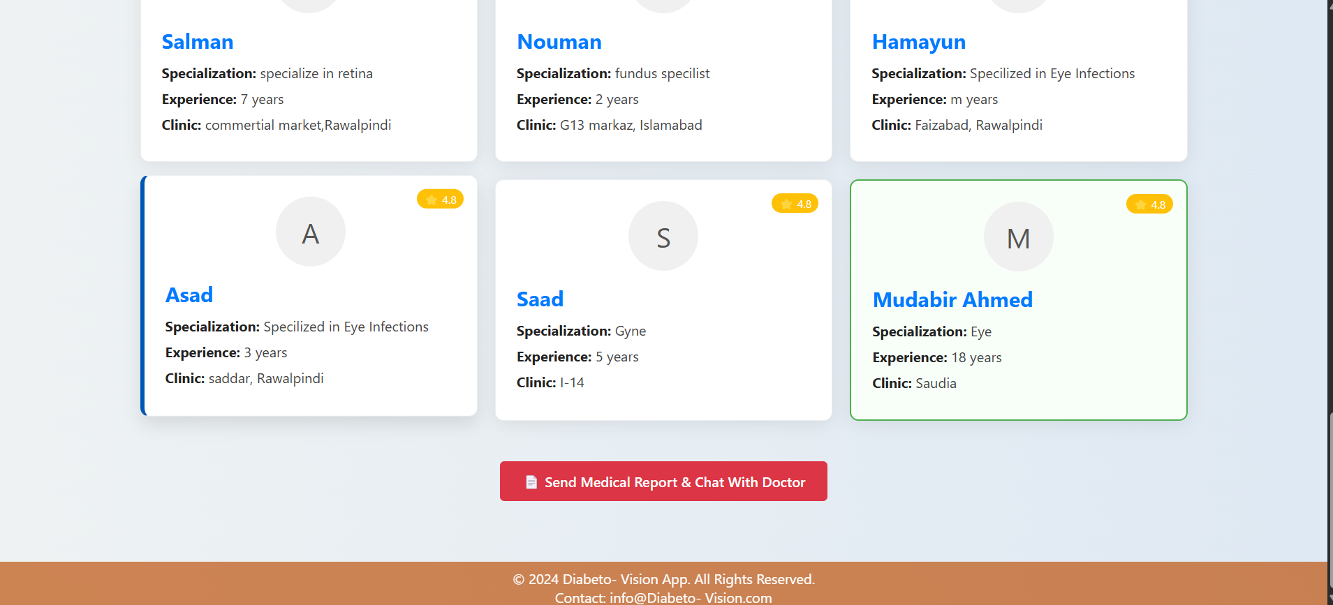
Outlook(10/16)
Send Medical Report:

Slide 48
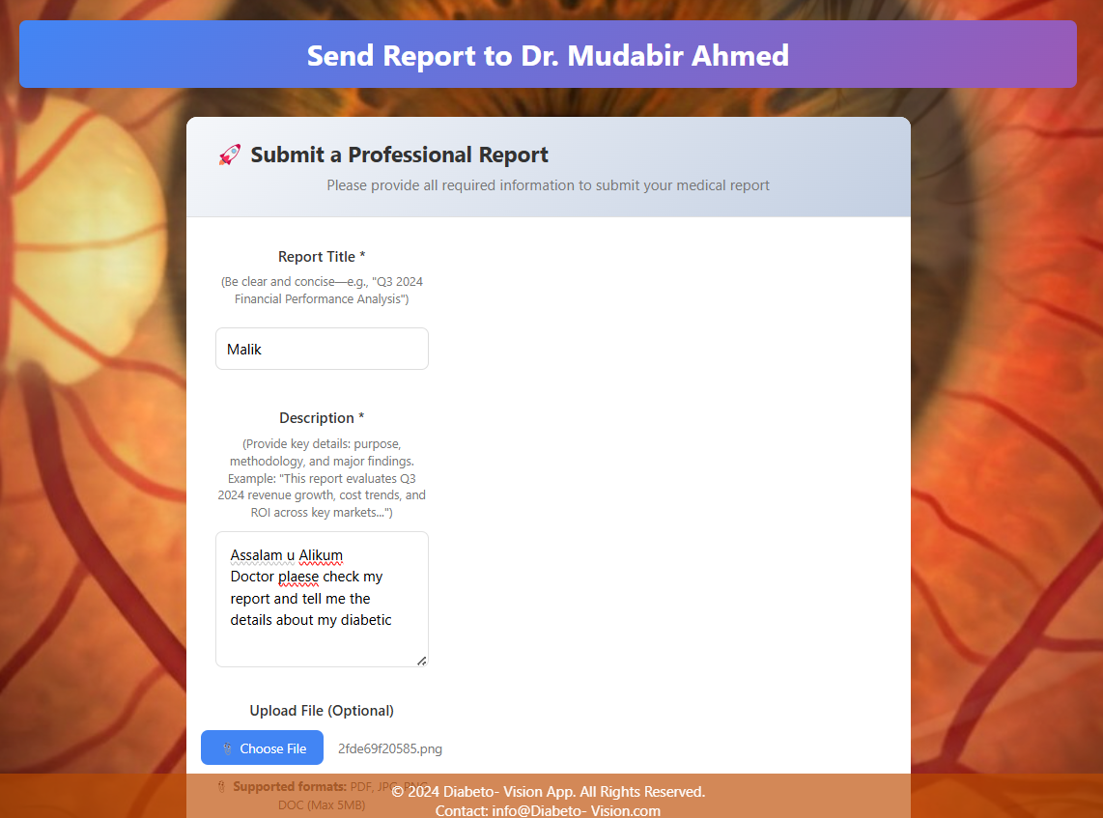
Outlook(11/16)
Sending Report:

Slide 49
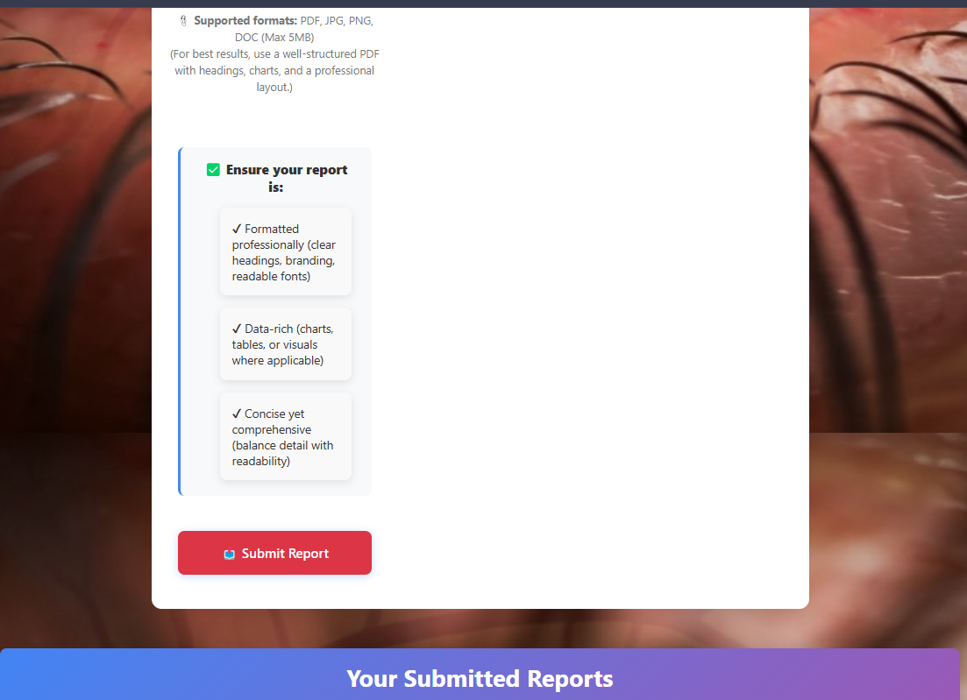
Outlook(12/16)
Submit Report:

Slide 50
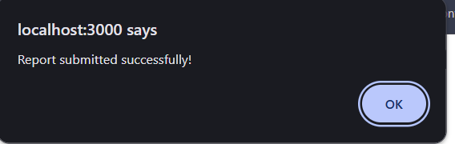
Outlook(13/16)
Report Submitted:

Slide 51
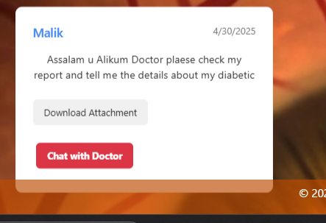
Outlook(14/16)
Attachment:

Slide 52
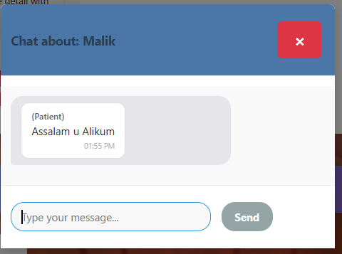
Outlook(15/16)
Chat with patient:

Slide 53
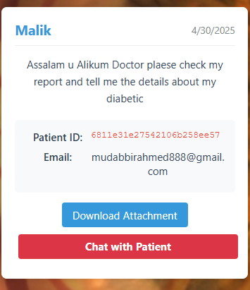
Outlook(16/16)
Patient chat:

Slide 54
Conclusion
Diabeto Vision successfully demonstrates the potential of deep learning in automating the detection of diabetic retinopathy from retinal fundus images. By leveraging advanced image preprocessing and CNN-based classification, the system accurately distinguishes between DR and non-DR cases, supporting early diagnosis and treatment. This tool can significantly reduce the burden on healthcare systems by assisting ophthalmologists in large-scale screenings, especially in under-resourced areas. While not a substitute for professional medical evaluation, Diabeto Vision lays a strong foundation for future enhancements and real-world clinical integration.

Slide 55
References
[1] R. Kommaraju and M. S. Anbarasi, “Diabetic retinopathy detection using convolutional neural network with residual blocks,” Biomed Signal Process Control, vol. 87, p. 105494, Jan. 2024, doi: 10.1016/J.BSPC.2023.105494.
[2] Y. Modaresnia, F. Abedinzadeh Torghabeh, and S. A. Hosseini, “Enhancing multi-class diabetic retinopathy detection using tuned hyper-parameters and modified deep transfer learning,” Multimed Tools Appl, vol. 83, no. 34, pp. 81455–81476, Oct. 2024, doi: 10.1007/S11042-024-18506-3/TABLES/8.
[3] S. P. Singh, P. Gupta, and R. Dung, “Diabetic retinopathy detection by fundus images using fine tuned deep learning model,” Multimed Tools Appl, Nov. 2024, doi: 10.1007/S11042-024-19687-7.
[4] S. Aftab, S. Akhtar, S. Aftab, and S. Akhtar, “Diabetic Retinopathy Severity Classification Using Data Fusion and Ensemble Transfer Learning,” Journal of Software Engineering and Applications, vol. 18, no. 1, pp. 1–23, Jan. 2025, doi: 10.4236/JSEA.2025.181001.
[5] M. H. Ashraf and H. Alghamdi, “HFF-Net: A hybrid convolutional neural network for diabetic retinopathy screening and grading,” Biomedical Technology, vol. 8, pp. 50–64, Dec. 2024, doi: 10.1016/J.BMT.2024.09.004.

